Slide 1




Parental care (親代撫育) in humans
parents provide their children with
food
shelter
clothes
chance to study
Notes:
Apple: https://unsplash.com/photos/qVywyNo9_-E
Clothes: https://unsplash.com/photos/dlxLGIy-2VU
Language: https://unsplash.com/photos/fgmf2Eyrwm4

Slide 2


Significance of parental care
increases the survival chance of the young
promotes healthy development

Slide 3
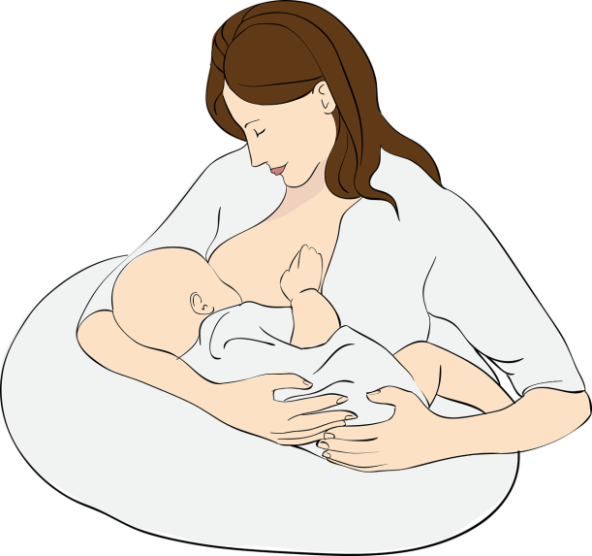
Breast-feeding (母乳餵哺)
the feeding of an infant or young child with breast milk
during pregnancy, mammary glands (乳腺) in the mother’s breasts enlarge and become able to produce milk

Slide 4

Breast-feeding (母乳餵哺)
when the baby sucks the nipples, the breasts are stimulated to produce and release milk
lactation (泌乳)

Slide 5
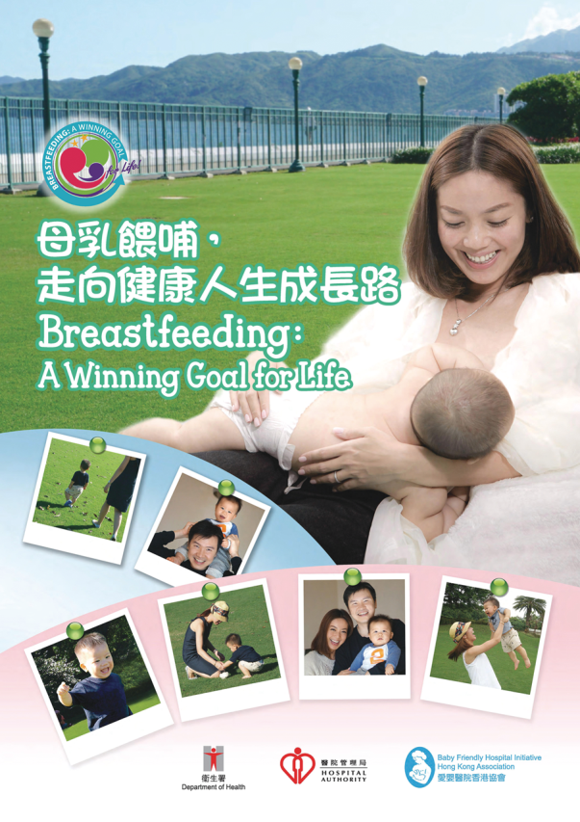
Benefits of breast-feeding for babies
breast milk contains the right amounts of all the essential nutrients for the baby
the protein in the breast milk is easy for babies to digest and absorb

Slide 6

Benefits of breast-feeding for babies
breast milk contains antibodies that help protect babies against some infectious diseases (e.g. pneumonia and ear infections)

Slide 7

Benefits of breast-feeding for mothers
helps the mother recover from childbirth
her uterus will return to its normal size more quickly
may reduce the risk of developing breast and ovarian cancers later in life

